Slide 1
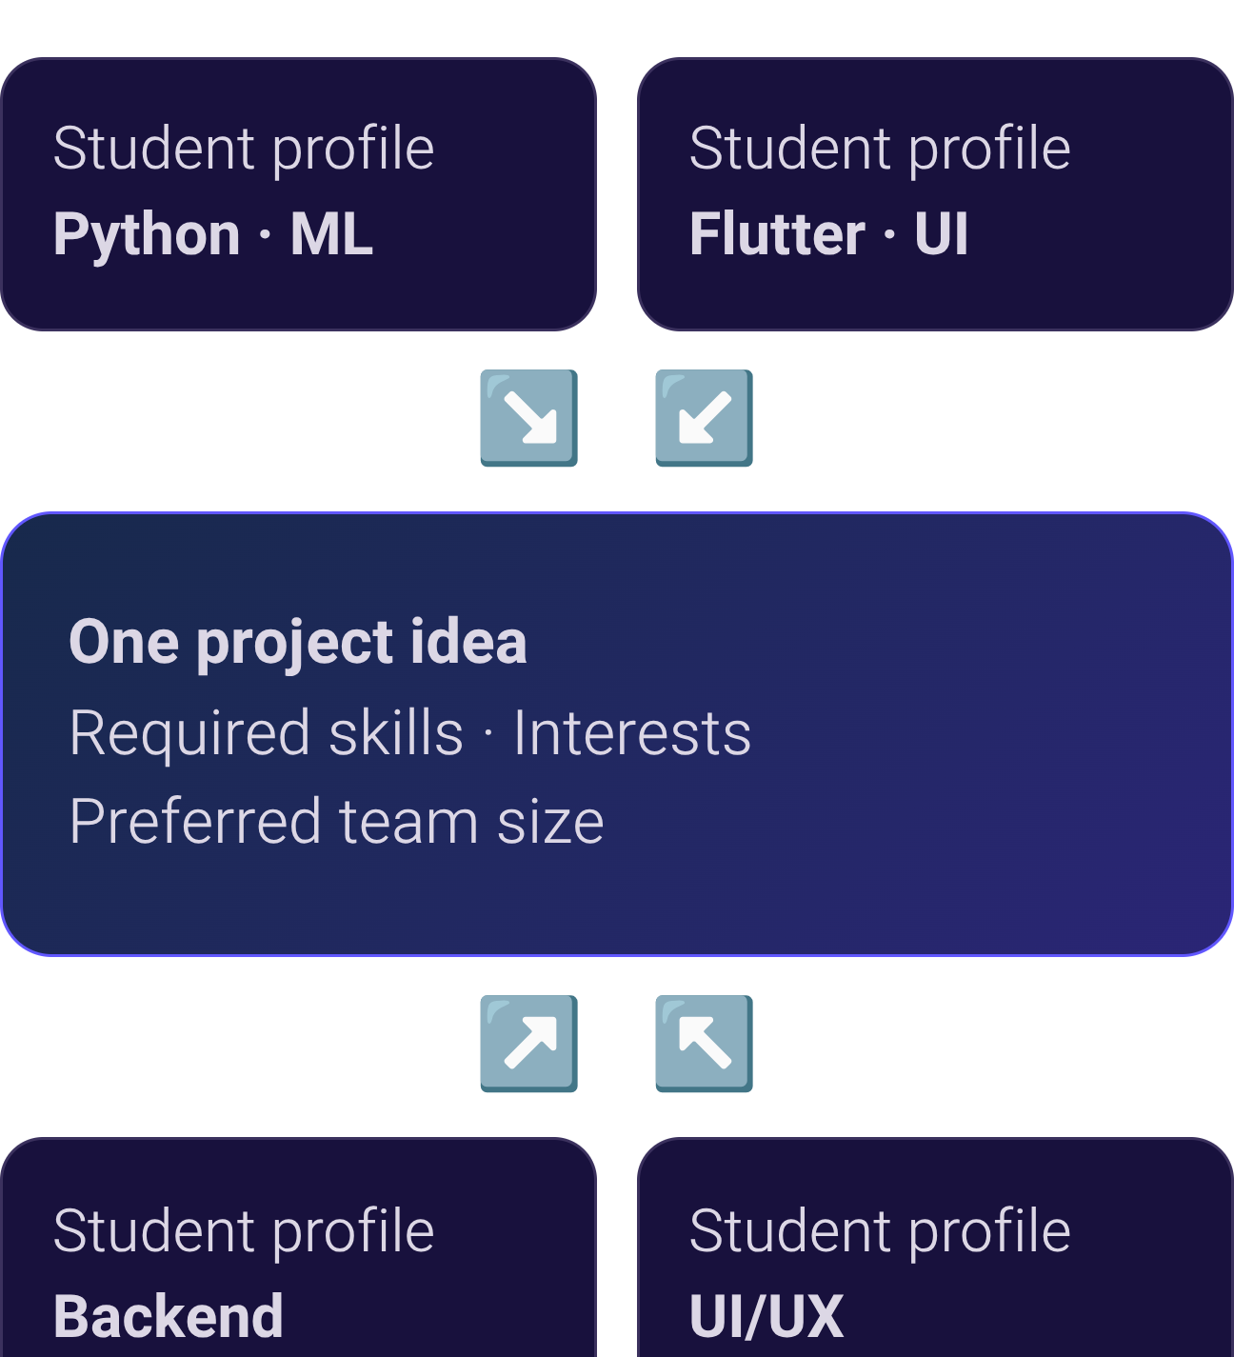
HACKTOBERFEST × IIT BHILAI
Innov8x
CONCEPT MOCKUP
Great ideas deserve the right team.
Find your people. Build something meaningful.
AI-Powered Student Skill & Project Team Matcher
Team Leader: Rahul Kumar
Team Members: Sumit Kumar · Deewakar Kumar · Rekyson Singh · Raghav Chouhan
Notes:
Innov8x is our proposed student skill and project team matcher. The concept connects project needs with complementary student profiles. We want students to spend more time building and less time searching.

Slide 2








Finding teammates shouldn't be harder than building the project.
Finding the Right People
Skill Mismatch
Collaborators outside existing friend circles are hard to discover.
Teams can lack essential technical or creative skills.
Time Lost
Limited Collaboration
Searching takes time away from building.
Talent remains undiscovered across classes and departments.
The challenge isn't always a lack of talent. It's finding the right combination of talent.

Slide 3
Meet Innov8x. From project idea to potential team.
01
02
03
04
Define Your Project
Discover Collaborators
Understand the Match
Build Your Team
Idea, required skills, interests and team size.
Review recommendations and choose collaborators.
Students with complementary skills.
Compatibility, roles and skill gaps.
CONCEPT MOCKUP
Project card
Recommended profiles
Skill-gap indicators
Your project idea
Student profile · Suggested role
Compatibility scores
[Calculated after matching]
Covered skills
Uncovered requirements
Review before choosing
REQUIRED SKILLS
Interests · Team size
The goal: Turn a project idea into a team ready to build it.
Notes:
This dashboard is a concept, not an operational product screenshot. No compatibility scores have been measured or supplied. The intended flow moves from a project brief to recommendations that students review themselves.

Slide 4
Beyond matching skills. Explaining why they fit.
INTENDED ARCHITECTURE
Input
Python Matching Engine
Gemma 4
Output
Student profiles + project requirements
Contextual explanations and role suggestions
Understandable teammate recommendations
Structured skill matching and compatibility calculations
Model: gemma-4-26b-a4b-it
Match explanations
Role suggestions
Skill-gap insights
Why listed skills are relevant to the project.
Responsibilities based on documented skills and interests.
Requirements that appear to remain uncovered.
Python-based logic evaluates structured compatibility. Gemma 4 adds contextual explanations and AI-assisted recommendations.
Recommendations support student decisions; they do not guarantee project success. 🙂
Notes:
This is the intended architecture, not a verified implementation. Structured matching and AI explanation have separate jobs: Python would evaluate compatibility; Gemma 4 would help students understand the recommendation.

Slide 5
One project. Complementary skills. A stronger starting point.
ILLUSTRATIVE DEMO SCENARIO · CONCEPT MOCKUP
Aarav, ML Developer
Rohan, Backend Developer
Python, Machine Learning
PROJECT
Smart Agriculture Assistant
FastAPI, Python, PostgreSQL
A mobile app that helps farmers identify crop diseases and access agricultural recommendations.
Priya, Mobile Developer
Ananya, UI/UX Designer
Flutter, Dart, UI Development
Figma, UI/UX Design, Prototyping
Skills covered: ML ✓ Mobile ✓ Backend ✓ UI/UX ✓
Potential gap: Agricultural domain expertise
Notes:
This is an illustrative team, not a real matching result. Innov8x helps students see who could contribute, how they might contribute, and what the team may still need. Even with technical coverage, agricultural domain expertise remains a potential gap.

Slide 6
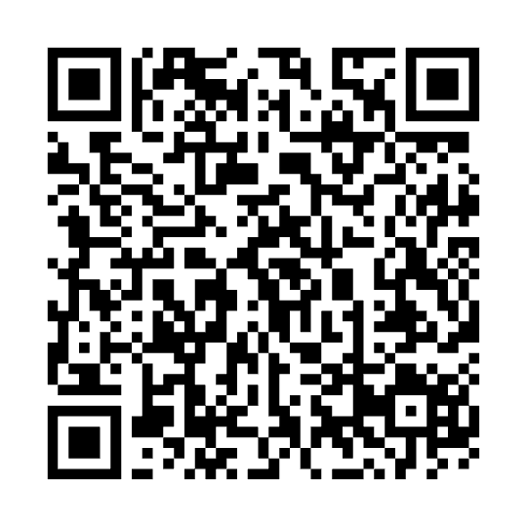
Built for campus collaboration. Designed to grow.
Technology
Expected impact
Future scope
Gemma 4: AI-assisted recommendations
Python: matching logic, if implemented
Application framework: [INSERT ACTUAL FRAMEWORK]
GitHub: open-source development
Make teammate discovery more accessible
Encourage collaboration across classes and departments
Help students identify complementary skills
Reduce reliance on informal networking alone
Collaboration requests
Persistent student profiles
Project progress tracking
Campus-wide project discovery
Better connections. Stronger teams. Bigger ideas.
·GitHub: [Repository URL]
‣Team: Innov8x
Notes:
The framework and public repository URL still need confirmation. The square is a QR placeholder, not a scannable code. Technology is proposed, impact is expected, and future features are scope rather than delivered capabilities.

